Slide 2
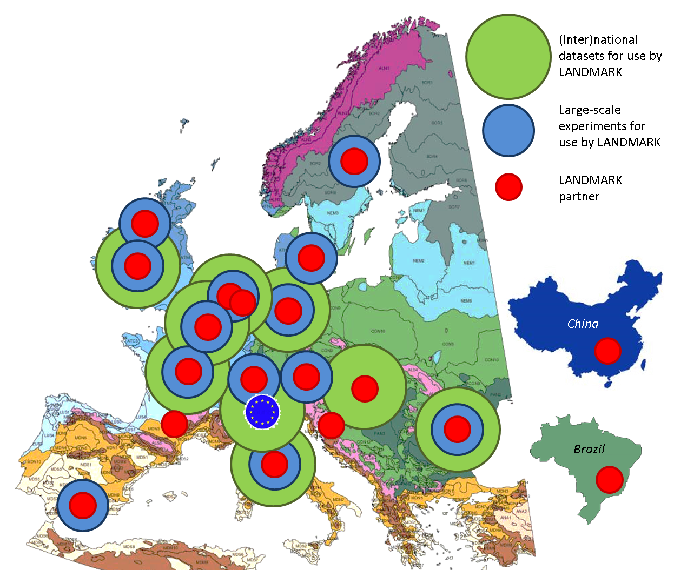
Landmark
Land management: assessment, research , knowledge base

Slide 3
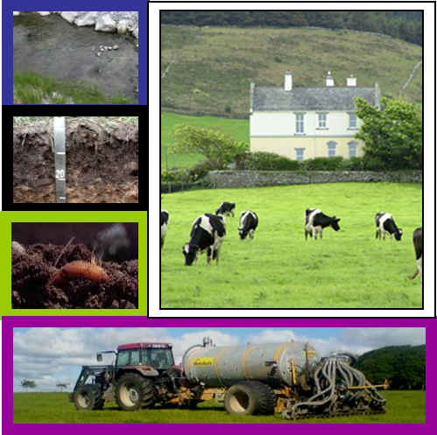
Landmark objective
Overall objective: to quantify the supply of soil functions across the EU as determined by soil properties, land use and soil management practices.

Slide 5
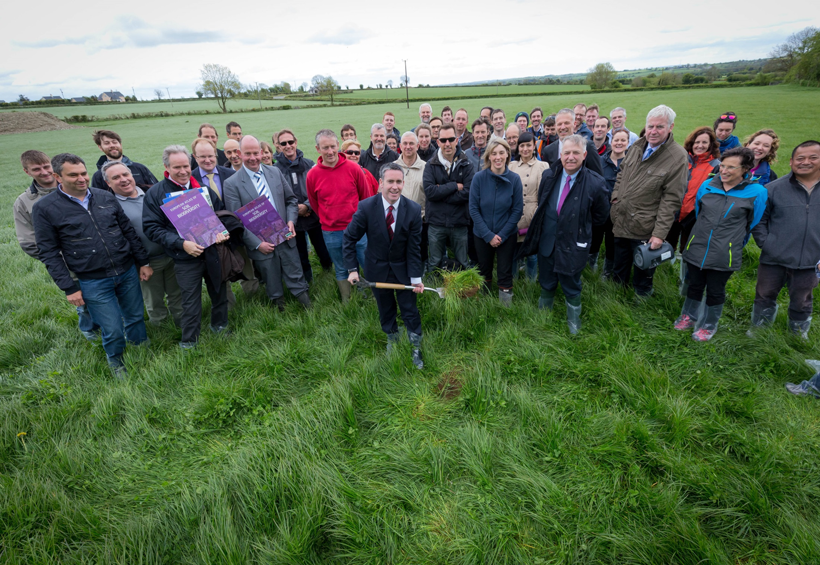
Thank you for your attention
Logo partner
email landmark@teagasc.ie twitter @Landmark2020

